Slide 1
CSE 713: ADVANCED SYNTACTIC PATTERN RECOGNITION
Task 2: Team presentation of a paper
Submitted by - Team 17
22366020- Muhammed Yaseen Morshed Adib
20201228- Munim Bin Muquith
22366023- Sovon Chakraborty

Slide 2
Paper we have chosen
Title: Co-LSTM: Convolutional LSTM Model for Sentiment Analysis in Social Big Data
Published in: https://www.sciencedirect.com/journal/information-processing-and-management
Doi: https://doi.org/10.1016/j.ipm.2020.102435
Author description: 1. Ranjan Kumar Behera, Dept of CSE, National Institute of Technology, Rourkela, India, jranjanb.19@gmail.com1
2. Monalisa Jena, Department of Information and Communication Technology, F. M. University Balasore, Odisha, India, bmonalisa.26@gmail.com2
3. Santanu Kumar Rath, Dept of CSE, National Institute of Technology, Rourkela, India, skrath@nitrkl.ac.in3
4. Sanjay Misra, Department of Electrical and Information Engineering, Covenant University, Ota 1023, Nigeria, sanjay.misra@covenantuniversity.edu.ng4

Slide 3
Abstract
In this paper, a hybrid approach of two deep learning architectures namely Convolutional Neural Network (CNN) and Long Short Term Memory (LSTM) (RNN with memory) is suggested for sentiment classification of reviews posted at diverse domains.
Deep convolutional networks have been highly effective in local feature selection, while recurrent networks (LSTM) often yield good results in the sequential analysis of a long text.
The proposed Co-LSTM model is mainly aimed at two objectives in sentiment analysis-
First, it is highly adaptable in examining big social data,
Secondly, unlike the conventional machine learning approaches, it is free from any particular domain.

Slide 4
Contribution of this paper
In the proposed approach, the CNN model is used for better feature extraction through a pooling process and the LSTM is adopted for capturing the long term dependency among words in a sentence.
To develop the sentiment analysis model, which should be domain-independent they have trained the deep learning architecture using reviews from four different domains where almost all kinds of word dependencies exist and evaluated the performance separately for each dataset.

Slide 5
Motivations
In the present world of digitization, social media available on the web is a big source of customer interactions and reviews. Sentiment analysis of such a huge amount of data helps to identify and track customer behavior about products, services, or brands . Customer feedback is essentially required in the decision-making process.
In this paper, they have adopted CNN for better feature engineering for the big social review data. However, it may not be suitable for capturing the contextual information from a given review as it doesn’t remember the past context. That‘s why they have adopted LSTM which is mainly suitable to capture the temporal contextual information. It is best suited for capturing the dependencies of words inside the reviews. It is mainly used for sequence prediction.

Slide 6
Research Challenges
Emoticons are the essential elements for short text or small reviews. Is the classifier model able to handle noisy data and emoticons?
To address this issue, proper feature engineering is desirable before training the classifier models. A huge text corpus has been referred to identify the incorrect spelling from the reviews. Google-1 (Billion word Corpus) has been used to handle the word which are misspelled.
How to capture the context of corresponding words or phrases in their numerical representation?
a word embedding layer is being considered to create a numerical feature matrix for capturing actual context present in the review text. Each word is being assigned a one-dimensional numerical vector that is self-trainable. Here the numerical vector is being constructed by passing through several training steps rather than by random assignment.

Slide 7
Research Challenges(Contd.)
3) How to capture the dependency between the words in a sentence for predicting actual sentiments?
To capture the sequential dependency or semantic representation of a review, a Long Short Term Memory (LSTM) layer is used. LSTM seems to be able to capture the long term dependency of words in the text with its unique architecture of having memory at each network.

Slide 8
Word Embedding Techniques
Converting Text into numbers
Quite important process
Maps word to vector
2 Types Embedding Techniques-
Frequency Based
Prediction Based

Slide 9
Deep Learning Techniques
Subset of Machine Learning
Representation Learning Techniques
Various Deep-Learning Models-
Convolutional Neural Network (CNN)
Probabilistic Neural Network (PNN)
Recurrent Neural Network (RNN)

Slide 10
Convolutional Neural Network (CNN)
Operates based on Convolution and Sub-sampling Process
5 layers of Convolutional Neural Network-
Convolution Layer
Pooling Layer
Fully Connected Layer
ReLu
Output Layer

Slide 11
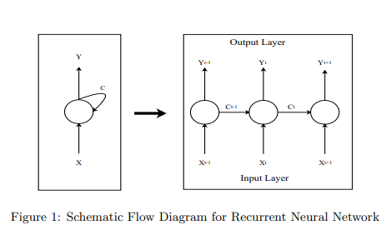
Recurrent Neural Network
Output from previous step fed as input to current state.
Simple structure with built in feedback loop.
Hidden state
Uses same parameter for each input.

Slide 12
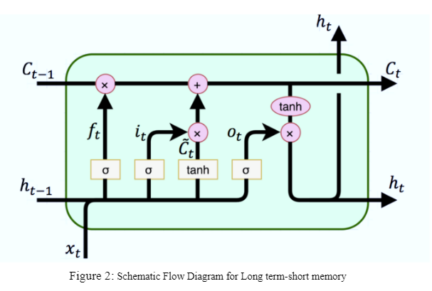
Long short-term memory
Sophisticated version of RNN
Solve vanishing gradient problem
Performs well in long term dependency case

Slide 13
Proposed Model
Presented approach passes through 3 layers
In first layer, Word-embedding is applied
In second layer, Conventional layer and pooling process is applied
LSTM Network is applied
Output passes to fully connected sigmoid layer
Evaluate the result using binary cross entropy

Slide 14
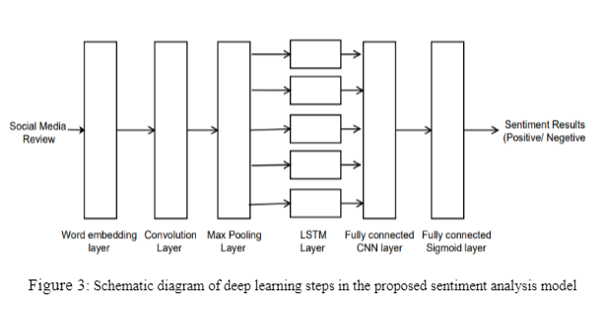
Proposed Approach
Step 1:
Preprocessing
Text Vectorization
Dimensionality reduction
Fed output to the Neural network Model
Step 2: Word embedding
Step 3: Convolutional layer
Step 4: Max-pooling layer
Step 5: Long Short Term Memory
Step 6: Sigmoid layer

Slide 15
Dataset Description
Four Datasets from diverse domains had been collected.
IMDB dataset contains 25,000 highly polar movie reviews (good or bad)
Airline review tweets had been used also that consist of three polarities.
Self driving dataset from kaggle.com.
US presidential election dataset that consist of 21 attributes and 13871 number of reviews.
Distinct fields are selected for developing a domain-independent sentiment analysis model.

Slide 16




Performance Evaluation Parameters
1.
2.
3.
4.

Slide 17
Result Analysis and Discussion
Highest Precision has been shown by the Naive Bayes algorithm in movie review dataset.
In terms of Recall, F-measure and accuracy Co-LSTM has outperformed the state-of-the art models in the same dataset.
Same things repeated regarding to other datasets also where Naive Bayes has the highest precision.
The proposed model has shown 94.96% accuracy that is greater than other models in Airline dataset.
Respectively 90.45% ,86.43% and 83.13% accuracy is obtained in US presidential election, Self driving and IMDB dataset.

Slide 18
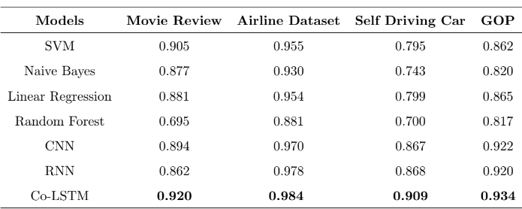
Area Under Curve Value for ROC Curve
The proposed Co-LSTM has the highest AUC value for ROC curve.
Fig 4: AUC Value for ROC curve

Slide 19
Conclusion and Discussion
Although the model can be applied for various domains, it requires huge amount of data in order to achieve good accuracy and precision.
In the case of word embedding, Pre-trained data corpus needs to be large enough to cover all frequently used words.
Convolution layer may fail to capture sequential dependencies where LSTM works like a fully connected layer where memory can be an issue.
Training of model becomes tough if any misspelled words and irregularities are found on the language used in the social media.

Slide 20
References
E. Cambria, Affective computing and sentiment analysis, IEEE Intelligent Systems 31 (2) (2016)
A. Severyn, A. Moschitti, Twitter sentiment analysis with deep convolutional neural networks, in: Pro-ceedings of the 38th International ACM SIGIR Conference on Research and Development in Information Retrieval, 2015, pp. 959–962.
Y. Wang, M. Huang, X. Zhu, L. Zhao, Attention-based lstm for aspect-level sentiment classification,
W. Yin, K. Kann, M. Yu, H. Sch ̈utze, Comparative study of cnn and rnn for natural language processing,arXiv preprint arXiv:1702.01923.
G. Vinodhini, R. Chandrasekaran, Sentiment analysis and opinion mining: a survey, International550 Journal 2 (6) (2012) 282–292.

Slide 21
Thank You

